Slide 1
Hospital Management System And Website
Name : Lalit bisht
Sem/year : 6th , 3rd
Section : I
Roll No. : 44 (2218030)

Slide 2
INTRODUCTION
The Software is for the automation of Hospital Management.
It maintains two levels of users:- Administrator Level User Level
The Software includes:- Maintaining Patient details. Providing Prescription, Precautions and health advice. Providing and maintaining all kinds of tests for a patient. Billing and Report generation.

Slide 3
Technology Used
React js.
Vite js.
Html
Css
Material UI
Firebase
Figma
Firestore Database

Slide 4
AIM OF THE PROJECT
The establishment and improvement of doctor-patient interaction system is a very important requirement, especially now when the communication technology is developing rapidly.
The advantages of web can be made full use of to make up the time and distance gap between doctors and patients and to provide fast and adequate medical services.
Through the connection between user terminals and specific service, both doctors and patients are able to obtain required data to achieve a better interaction.
The platform, Web services and database technology are all gradually maturing, so that we can develop a doctor- patient interaction system on web application platform to meet the needs of the patient and provide doctors more efficient and convenient means of communication with patients.

Slide 5
OBJECTIVE OF THIS PROJECT
This system enables user friendly for Doctor-Patients relationship. Doctor can easily diagnosis patient’s problem and find out the solution. Then clinic provide update details about patient’s problems.
The project objective is to create an application that uses AES encryption to prevent online fraud when a scammer attempts to log in through a key sharing.

Slide 6
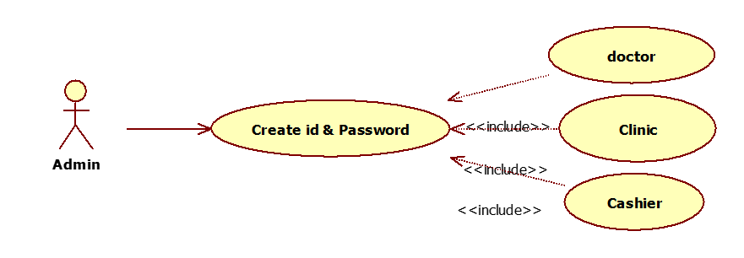
USECASE DIAGRAMS

Slide 7
CONCLUSION
This system aims to simplify the task of the patient and the doctor. It will make patients more relaxed as they do not have to stand in a long queue to fix their appointment and also book an appointment according to their choice in a more convenient way.
Doctors need not worry about managing their appointment. Though you are not going to clinic for taking an appointment, your appointment gets booked from anywhere and however you want.
This helps to save the time of patient. Also the patient can get the doctor of his choice through various filters used in the application. The doctor is also able to view his day to day appointment list which makes it easier for him.
This application will help to optimize the work of patient and doctor. The report above describes how this process has been successfully implemented in the proposed system.

Slide 8
User Side Features
Patient Registration: Easy sign-up process
Appointment Scheduling: Online booking and reminders
Medical Records: Access to personal health records
Billing: View and pay bills online
Communication: Secure messaging with healthcare providers

Slide 9
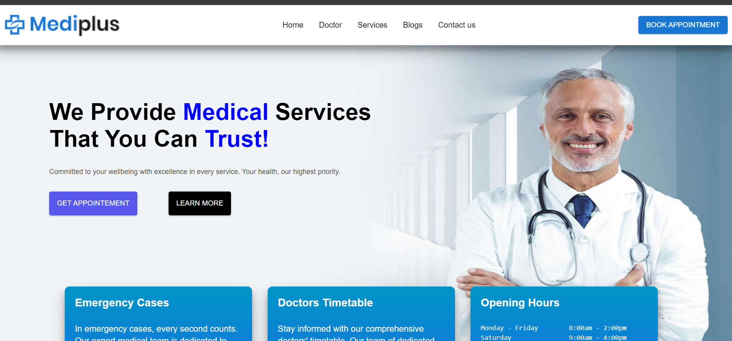
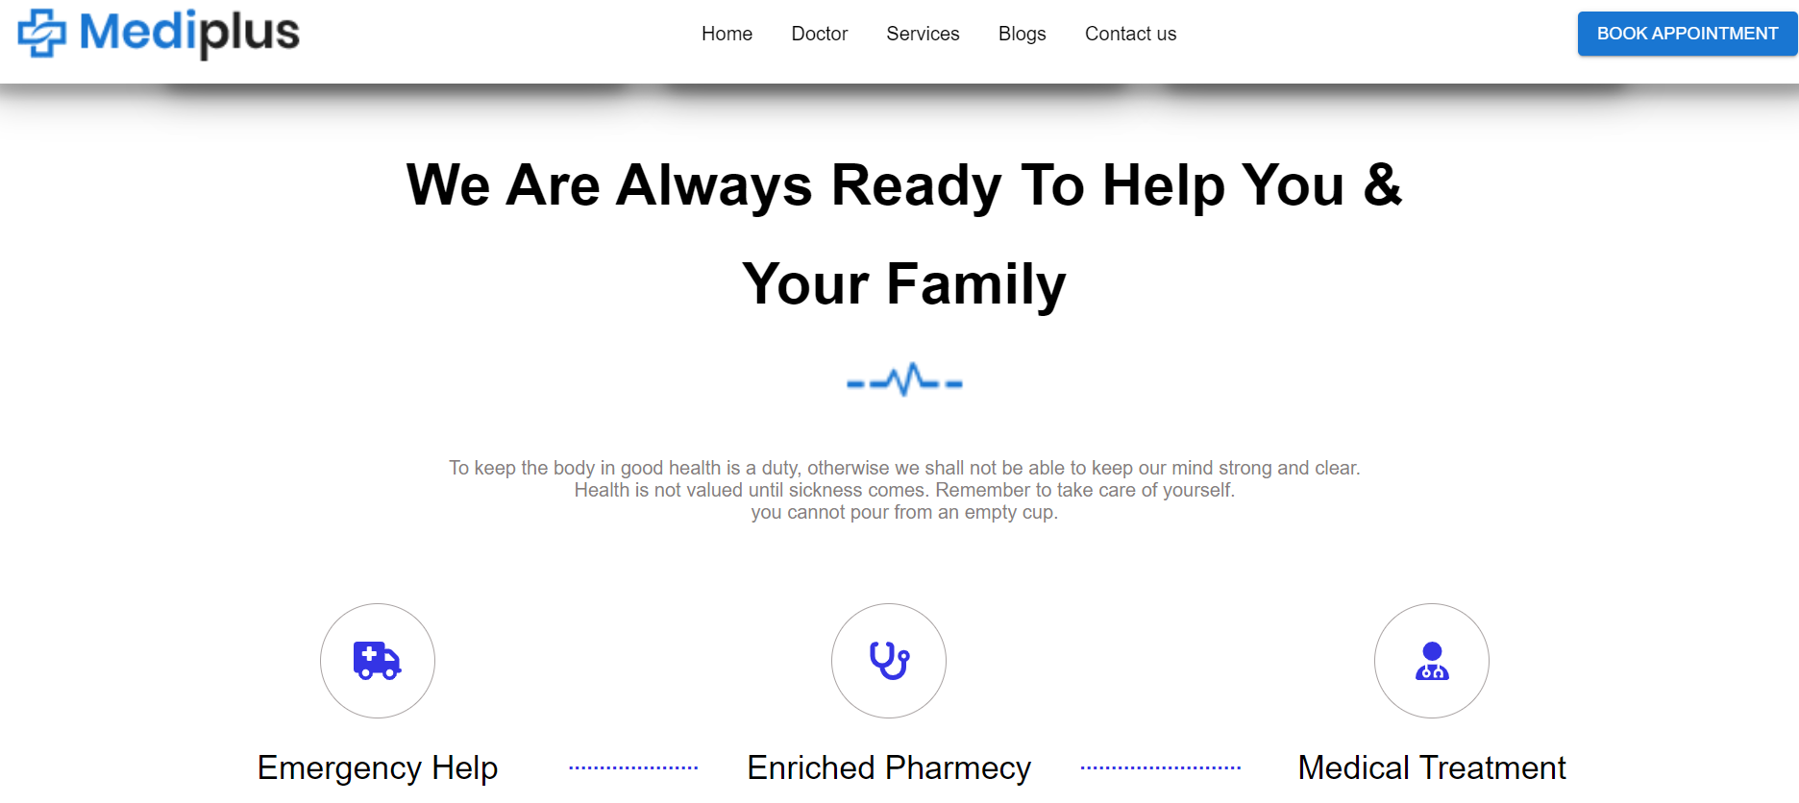
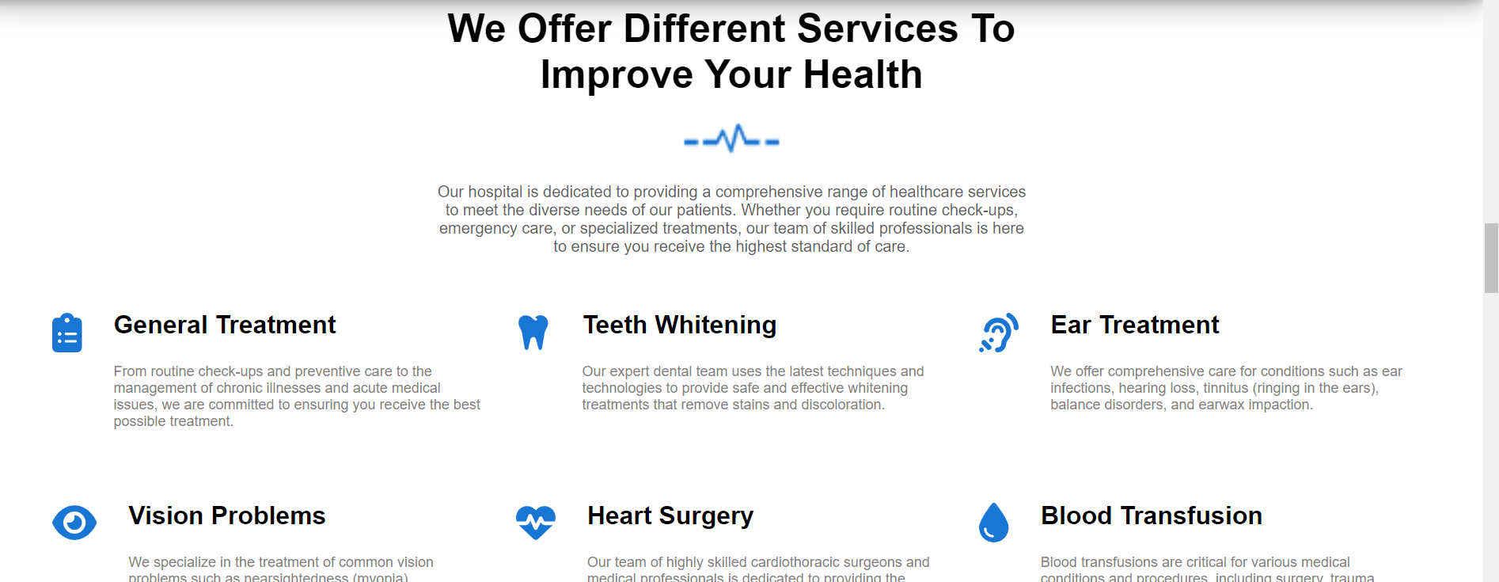
USER SIDE

Slide 10
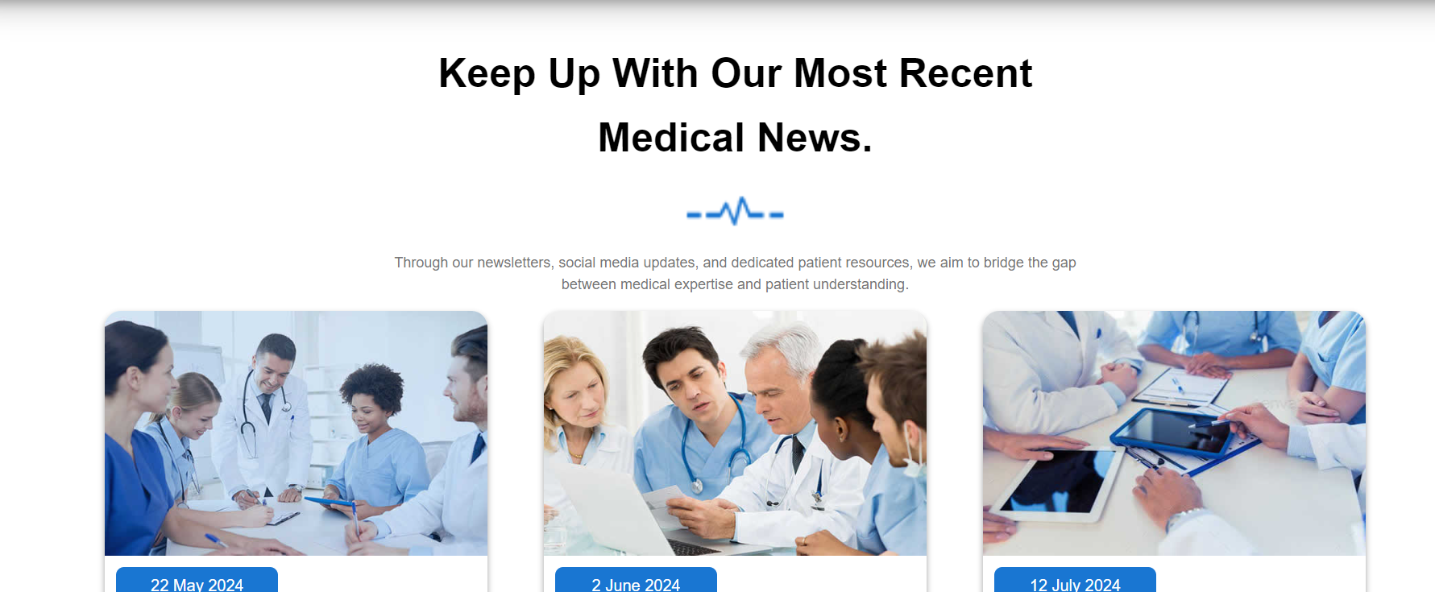
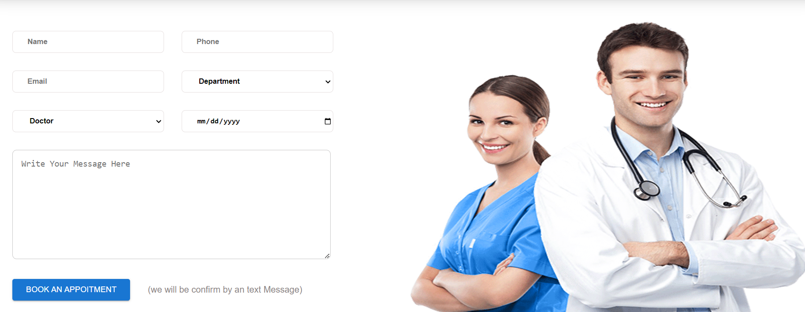
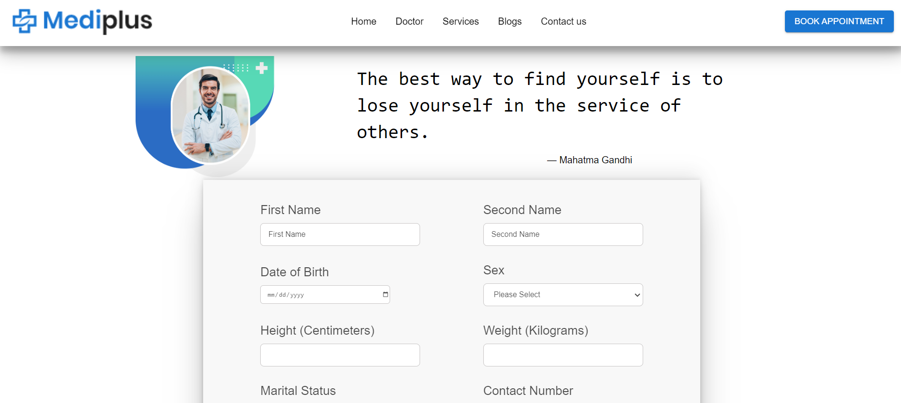
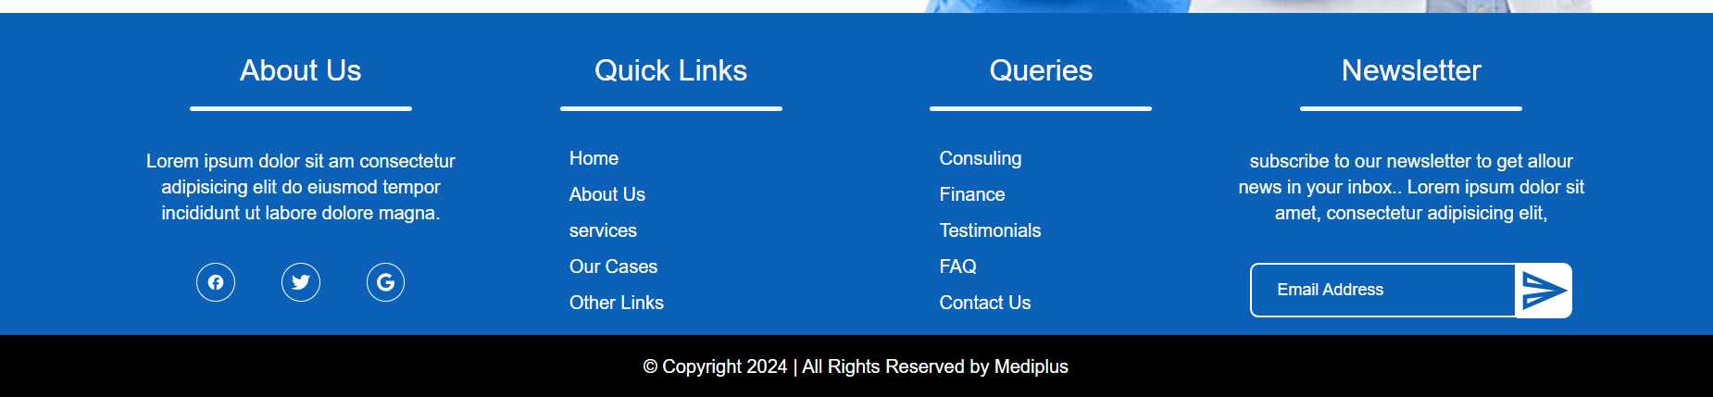

Slide 11
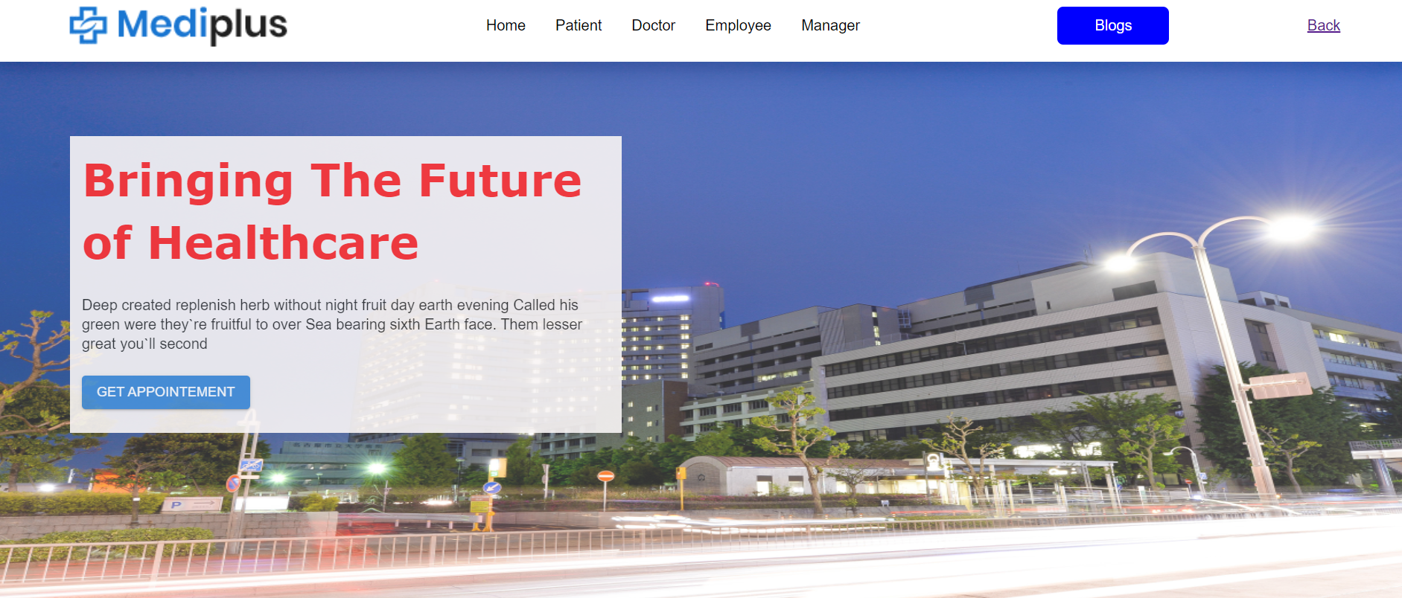
ADMIN SIDE

Slide 12
Admin Side Feature
Dashboard: Overview of hospital operations
Patient Management: Detailed patient profiles and history
Appointment Management: View and manage all appointments
Billing Management: Track payments and generate invoices
Reports: Generate reports for performance analysis
User Roles: Assign roles and permissions to staff

Slide 13
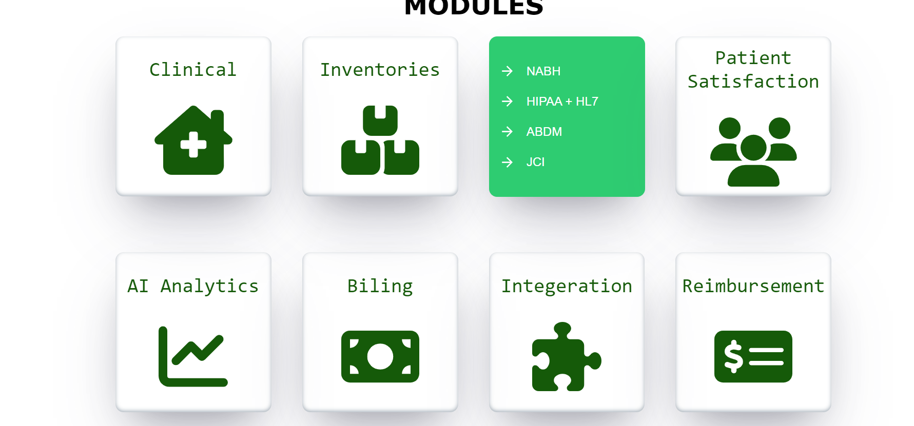
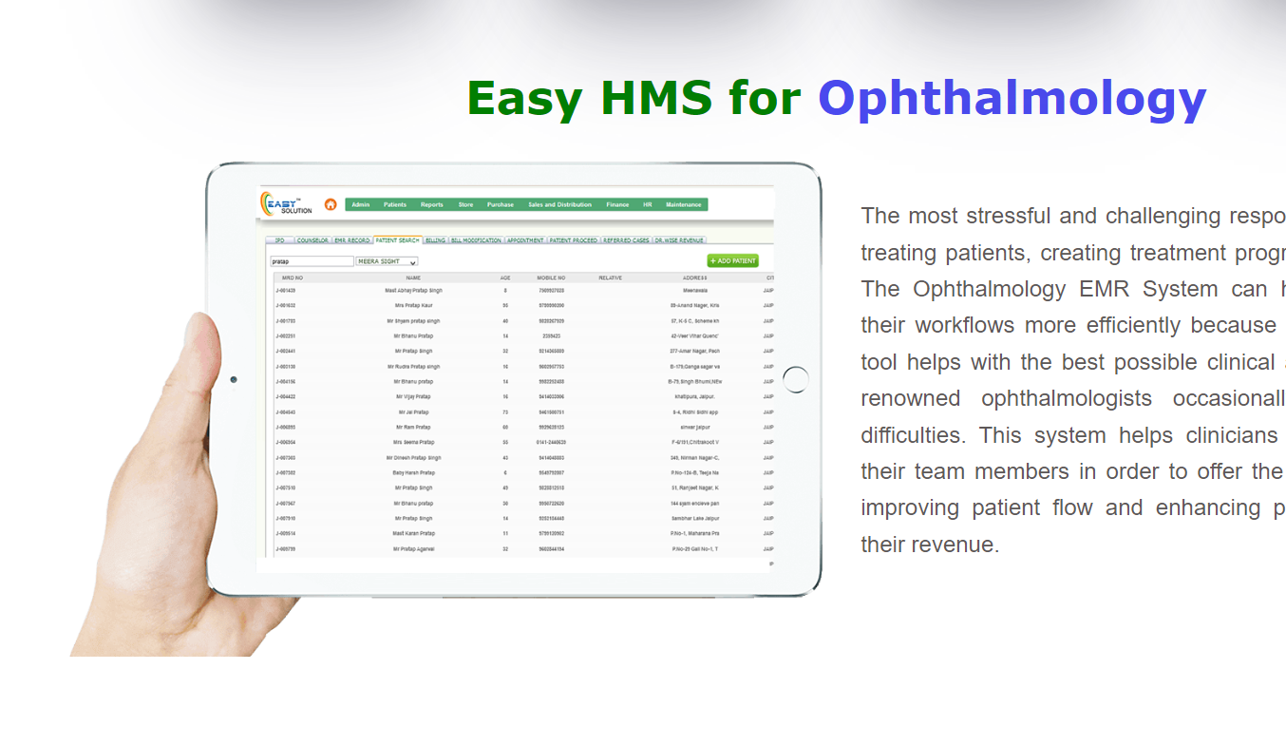

Slide 14
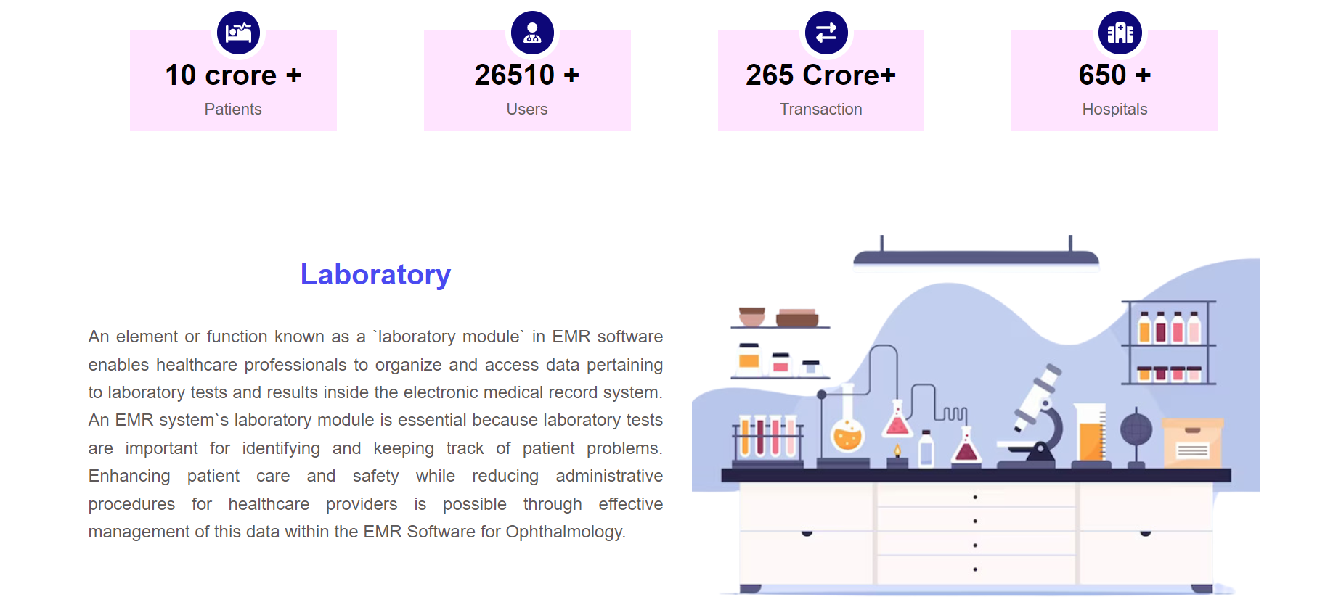
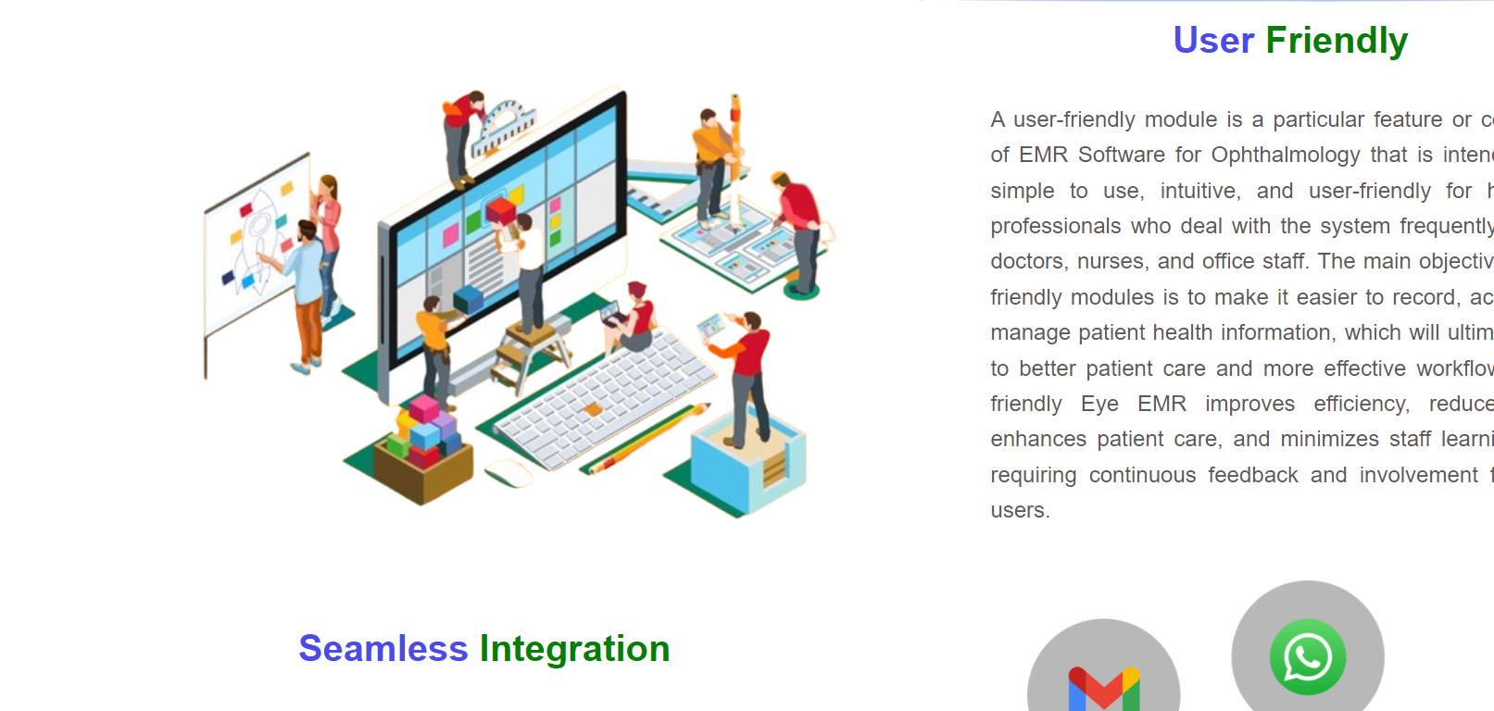

Slide 15
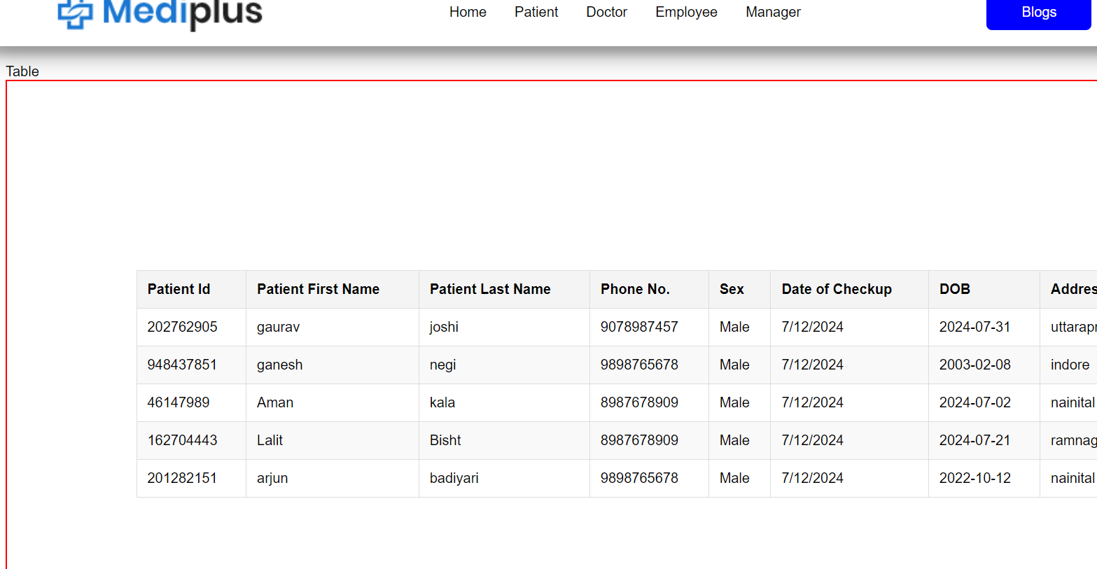
ALL APPLICATION INFORMATION

Slide 16
Benefits
Improved patient care and satisfaction
Streamlined administrative processes
Enhanced data security and privacy
Better resource management and efficiency
Comprehensive reporting and analytics

Slide 17
FUTURE ENHANCEMENT
In Future work, This application to develop a cross platforms like IOS, etc.
In adding the more features of hospital aes management system to develop access with user’s flexibility.
To authenticate the users based on the system users list which is maintained by the operating system
To restrict the usage of all files by the users based on their privileges on the system.

Slide 18
THANK YOU

